Slide 1

Rhode Island Commission for Human Rights
Special Legislative Commission
Overview of RICHR Housing Work
December 5, 2024
Lauren E. Hill, Chief Legal Counsel
Lauren.hill@richr.ri.gov; 401-222-4477

Slide 2
What does the Commission Do?
Overview
Laws Enforced/Investigated
Notes:
Commission’s ROLE
PROCESS
What you should know

Slide 3

About the Commission
Enforces State and Federal anti-discrimination laws
  Employment
  Housing
  Public Accommodations
  Credit
  Delivery of Goods and Services
Neutral, objective investigative agency
Services free of charge

Slide 4
About the Commission
7 members to be appointed by the governor, with the advice and consent of the senate,
Commissioner characteristics:
  demonstrated sensitivity to the concerns of the classes protected under this chapter.
  judicious temperament, analytical ability, and sufficient time to dedicate to commission work.
  reflect the diversity of the state’s population.
  governor should attempt to appoint at least one with a background in law, business, and/or real estate.
R.I. Gen. Laws sec. 28-5-8

Slide 5
About the Commission
15 Commission staff:
  Executive Director
  2 attorneys
  EEOC Project Director
  HUD Project Director
  Chief Compliance Officer
  3 administrative staff
  6 investigators (4 senior compliance officers and 2 investigators)

Slide 6
State Laws Enforced
Fair Employment Practices Act (“FEPA”) - R.I. Gen Laws § 28-5-1 et seq.
Fair Housing Practices Act (“FHPA”) - R.I. Gen Laws § 34-37-1 et seq.
Civil Rights of People with Disabilities Act (“CRPDA”) - R.I. Gen Laws § 42-87-1 et seq.
Equal Rights to Public Facilities Act (“ERA”) - R.I. Gen Laws § 40-9.1-1 et seq.
Hotels and Public Places Act - R.I. Gen Laws § 11-24-1 et seq. (Discrimination in Public Accommodations)
HIV/AIDS – R.I. Gen. Laws § 23-6.3-11, 12 (discrimination based on HIV/AIDS prohibited
Notes:
Lauren
Civil Rights – no discrimination in business, denied participation in program/service for state or state-funded programs –
this is statute under which we take police complaints
ERA guarantees access for service animals
HIV/AIDS prohibits discrimination in housing, education, employment, the granting of credit, public accommodation, or delivery of services on basis of positive test (or perceived positive) and prohibits HIV testing as condition of employment

Slide 7
Federal Laws Investigated
Title VII of the Civil Rights Act of 1964 - employment.
Fair Housing Act, Title VIII of the Civil Rights Act of 1964
Age Discrimination in Employment Act
Americans with Disabilities Act (“ADA”)
Notes:
Lauren
Commission has contracts with Equal Employment Opportunities Commission (EEOC) and U.S. Dept Housing and Urban Development (HUD)
Investigate federal anti-discrimination statutes
Age discrimination in employment – 40+, in housing, can have 55+ communities
FEPA – Title VII
FHPA – Title VIII
Civil Rts Ppl Disabilities - ADA

Slide 8
Complaint Distribution
14% of overall of charges taken in at RICHR are for Housing Discrimination – FY 2024
ALL CASES
48% - Disability
34% - Retaliation
24% - Sex
21% - Race
18% - Color
HOUSING
76% - Disability
13% - Source of Income
13% - Race
10% - Sex
10% - Color
07% - Retaliation
These percentages add up to more than 100% because some charges allege multiple bases. If a charge alleges discrimination on the bases of age, race and disability, it is included in all three categories.
www.richr.ri.gov
Notes:
Lauren Stats from FY 2024
These stats are for ALL cases, not just housing
383 total intake (30% increase of FY22) – 79% employment; 14% housing
Intake in first quarter for housing cases DOUBLE previous year
Avg. closure time – 332 days
PC – 8%
NPC – 30%
Settled before determination – 20%
Disability is also the most common housing complaint and the majority have to do with assistance animals
Not a complete list of protected categories – just the top five

Slide 9
How does the Commission address discrimination charges?
Investigation Process
Protected Categories
Notes:
Lauren

Slide 10
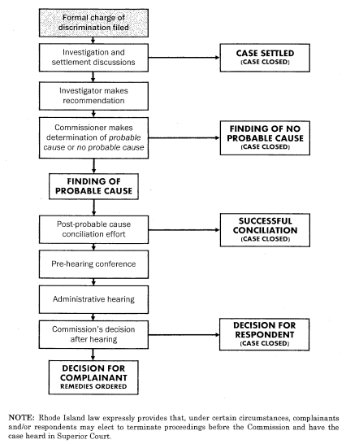
Charge Process Summary
www.richr.ri.gov
Notes:
John

Slide 11
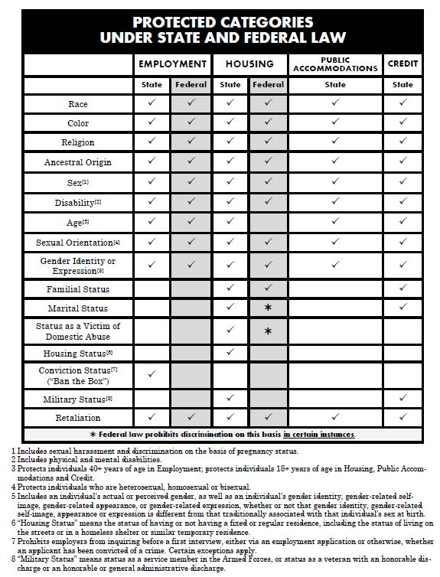
Notes:
Lauren
This is a chart we’ll give you comparing protected categories across the domains in state and federal law

Slide 12
Protected Categories
Race
Color
National/Ancestral Origin
Physical Disability
Mental Disability
Age
Sex
  Pregnancy
  Sexual Harassment
Religion
Sexual Orientation
Gender Identity or Expression
Familial Status*
Marital Status*
Military Status*
Victim of Domestic Abuse
Housing Status (Homelessness)
Lawful Source of
Income
- Orange categories are only protected under fair housing law, not employment
- Starred categories* are also protected under fair credit law
Notes:
This is the “who” is protected
Military status, housing status, lawful source of income and victim of domestic abuse are state only categories

Slide 13
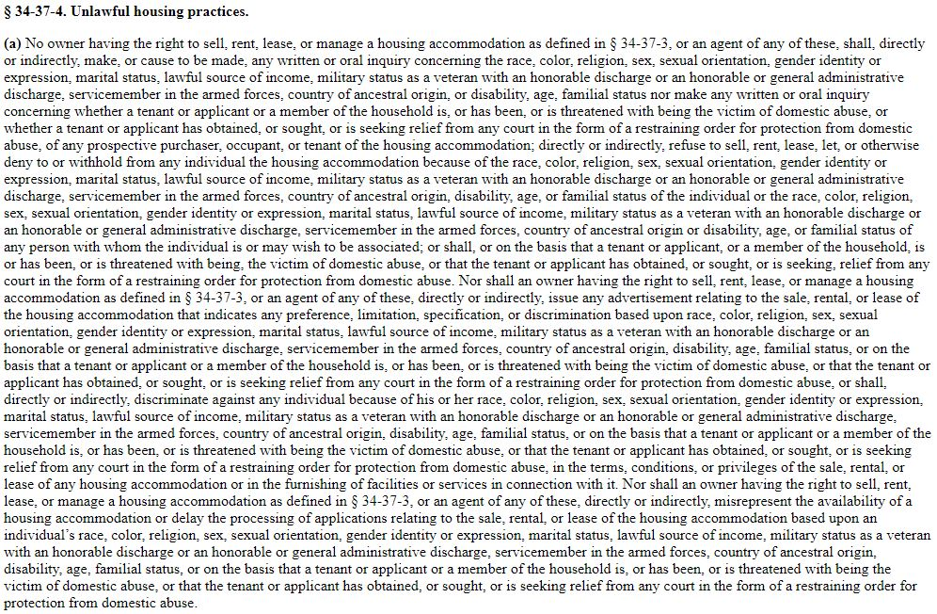
Notes:
This is the first subsection of the FHPA – it is impossible to parse

Slide 14
Prohibited Acts
R.I. Gen. Laws sec. 34-37-4, 34-37-5.1
Inquiring about protected category;
Refusing to sell, rent based on protected category;
Issuing discriminatory advertisements;
Discriminate against any individual because of protected category;
Applying different terms, conditions, or privileges of the sale/rental, or different facilities or services;
Misrepresenting the availability of a housing accommodation;
Delaying applications processing;
Notes:
This is the “what”

Slide 15
Prohibited Acts
Refusing to make reasonable modifications for disability;
Refusing to make reasonable accommodations for disability;
Aiding or abetting an unlawful housing practice;
Discriminating against someone for reporting unlawful housing practice or opposing unlawful housing practice;
Interfering, coercing, intimidating, threatening someone for exercising protected right or assisted someone else in exercising a protected right.
Notes:
Modifications is changes to physical environment; accommodations are usually adaptations to policies
Anti-retaliation provision

Slide 16
Mrs. Murphy Exemption*
4 units or fewer
State Law- familial status
Two units or fewer and owner occupied, OR
Owner occupied
Four units or fewer, one owner occupied, and one occupied senior for whom presence of children would constitute a hardship, OR
Senior Housing (55+ and 62+)
* = Does not apply to advertising
Federal Law

Slide 17
Lawful Source of Income
An owner may not refuse to rent, offer different terms and conditions of rental, misrepresent the availability of housing based on a prospective resident’s lawful source of income.
An owner may not advertise housing with a preference, limitation or specification based on lawful source of income.
R.I. Gen. Laws § 34-37-4(a).
Notes:
This is state-only category. Because statistically section 8 vouchers go to people who belong to minority groups, such as disability, people of color, we have co-filed with HUD if the complainant belongs to one of those minority groups because of disparate impact

Slide 18
Source of Income
The term “lawful source of income” means and includes any income, benefit, or subsidy derived from child support; alimony; Social Security; Supplemental Security Income; any other federal, state, or local public assistance program, including, but not limited to, medical or veterans assistance; any federal, state, or local rental assistance or housing subsidy program, including Section 8 Housing Choice Vouchers as authorized by 42 U.S.C. § 1437; and any requirement associated with such public assistance, rental assistance, or housing subsidy program.
R.I. Gen. Laws § 34-37-3(18).
Notes:
What is lawful source of income?

Slide 19
Lawful Source of Income
Types of income covered:
Section 8
Social Security
Disability
Alimony
Child Support
Veterans Administration Loans
Rent relief
Others?
One exemption:
3 units or fewer and owner occupied

Slide 20
Lawful Source of Income
Some prohibited acts:
Set different terms, conditions or privileges of rental for a voucher holder;
Refuse to comply with a requirement of the rental assistance program by, for example, refusing to provide the necessary paperwork or by insisting on a cash payment.
Tell a voucher holder that housing is not available for rent in order to avoid renting a property to them;
Place an advertisement for housing that says people with vouchers cannot apply or otherwise discourages them from applying; or
Use qualification criteria or procedures that would exclude voucher holders, (e.g. evidence of employment-based income)
Notes:
Some objections/defenses:
Must offer one-year lease to begin with: CHRO v. Sullivan, 739 A.3d 238 (Ct. 1999)
“whether the broad prohibition against discrimination based on source of income requires landlords to adhere to the requirements of the section 8 program for prospective section 8 tenants, or whether a landlord's insistence on using its own lease constitutes a defense to the antidiscrimination mandate.”
“to allow an exception to its antidiscrimination provisions for those landlords who refuse to use the required section 8 lease, would eviscerate the basic protection envisioned by the statute. It would lead to the unreasonable result that while the legislature mandated that landlords may not reject tenants because their income included section 8 assistance, the legislature at the same time also intended that landlords might avoid the statutory mandate by refusing to accede to a condition essential to its fulfillment.”
Screening company disproportionately screened out section 8 holders: Louis v. Saferent Solutions, 685 F.Supp.3d 19 (D.Mass. 2023). Section 8 holders tended to have lower credit scores, so screening disproportionately eliminated HCV holders (MTD case)
Realtor/Broker said owner didn’t want to wait for section 8 process to rent unit: 272 A.3d 150 (Ct. 2022) repeatedly said to applicant you didn’t inform me about section 8 before, owner doesn’t want to wait, indicating section 8 was barrier for renting
Recently, landlord refused to sign paperwork that would have allowed use of subsidy for rental deposit
Assessing a property fee on top of rent (voucher can’t be used for anything besides rent)

Slide 21
Lawful Source of Income
Some possible discriminatory advertisements:
Proof of employment income required;
Not Section 8 certified;
Good credit, references, employment and income history needed;
Must have strong credit and verifiable employment to be considered.
Notes:
RI has issue with its discriminatory advertising provision – it doesn’t cover statements (just adverts), so if landlord or agent says something discriminatory in person it may not be covered

Slide 22
Reasonable Accommodations/Modification
Changes in policies or structure that allow individual with disability to gain equal access to housing
Request Made
Request Form
Doctor’s Note
(if appropriate)
Interactive Process
(if denied)

Slide 23
Reasonable Accommodation vs. Reasonable Modification
Reasonable
Modification
Grab bars
Ramps
Lowering of counters*
Other structural changes*
= If landlord/owner cannot afford to modify the unit, tenant may offer to pay but must restore to original condition after moving out.
Reasonable Accommodation
Change in Policy
Exemptions to Policies
  Assistive Animals
Other Misc. Accommodations
  Parking spaces
  Live-in Aide
  Unit transfers

Slide 24
Assistive Animals
Animals as reasonable accommodation
  Not considered pets
  Some pet policies do not apply
  Insurance must accommodate
Service animals
  Certified
  Perform specific service (ex: Seeing Eye Dog)
Emotional Support Animals
  Does not need to be certified
  Note can be from psychologist, psychiatrist, LICSW, Doctor

Slide 25
Common Defenses
Undue Burden
Unable to accommodate or modify due to financial or administrative cost
Direct Threat
Accommodating tenant will put themselves or others at significant risk of substantial harm
Notes:
Currently, allergies – we ask them to verify
Undue burden – guy asked condo to install elevator in his unit

Slide 26
Familial Status
Families with Minor Children
Occupancy defense
  Number of people per bedroom
Different rules for children and adults

Slide 27
Prohibited Acts
Terms and Conditions
Must live on 1st floor
Must pay additional security deposit
Refusal to rent
State do not want children on property
Not enough bedrooms in unit – too small
Harassment
Neighbors harass children or parents
Landlords/owners fail to take action to end harassment
Children can access certain parts of property

Slide 28
Race/Color/National Origin
Race
Color
Where you or your ancestors are from
Ethnicity (common sociocultural traits)
National Origin
Physical characteristics associated with race
Skin shade/tone
African American/Black
White
Asian
Biracial
Light
Dark
Chinese
Hispanic
Dominican
Middle Eastern
Native American
* These often overlap!

Slide 29
Steering
Restricting an individual’s housing choice
Either directing towards or away certain neighborhood based on race/color/national origin
Can be done via words or conduct
  Showing houses/apartments only in certain neighborhoods
  Saying “You may be more comfortable living in X neighborhood”

Slide 30
Sex Discrimination
Discrimination based on male, female or other genders/sexes
Also covers pregnancy and sexual harassment
Pregnancy may also involve familial status as well in limited circumstances

Slide 31
Sexual Orientation vs. Gender Identity or Expression
Sexual Orientation
  Who you are attracted to
    Straight, gay, bisexual, pansexual, asexual, etc.
Gender Identity or Expression
  Actual or perceived gender
  Gender-related self identity or self expression
  Gender Stereotyping
    Assigning societal “norms” to conform with sex assigned at birth

Slide 32
Military Status
Active or Retired Military
All discharge types covered except dishonorable discharge
Prohibited Acts:
  Refusing to take VA loan from buyer
  Charging different rates of rent for military
  Creating policies targeting military (Requiring orders to be submitted for rental)

Slide 33
Harassment
Quid Pro Quo
Hostile Environment
Landlord/Owner can be liable for conduct of
  Neighbors
  Property Managers
  Third Parties (maintenance, landscapers, etc.)
Not limited to just sexual harassment

Slide 34
Retaliation
Helping someone else with their discrimination complaint
Testifying in investigation or hearing of discrimination complaint
Filing a charge of discrimination
Complaining about discrimination
Requesting a reasonable accommodation

Slide 35
Questions?

Slide 36
Contact Us!
Rhode Island Commission for Human Rights
180 Westminster Street, 3rd Floor
Providence, RI 02903
Hours: Monday through Friday, 8:30 AM to 4:00 PM
Tel: 401-222-2661
Voice Relay: 7-1-1
Fax: 401-222-2616
Website: www.richr.ri.gov

